Slide 1
MULTI-AGENT AI & SECURITY RESEARCH
An LLM-Based Multi-Agent Code Generation, Review, and Vulnerability Explanation System with Local LLM Deployment
Technical Architecture, Collaborative Pipeline & Security Audit Presentation

Slide 2
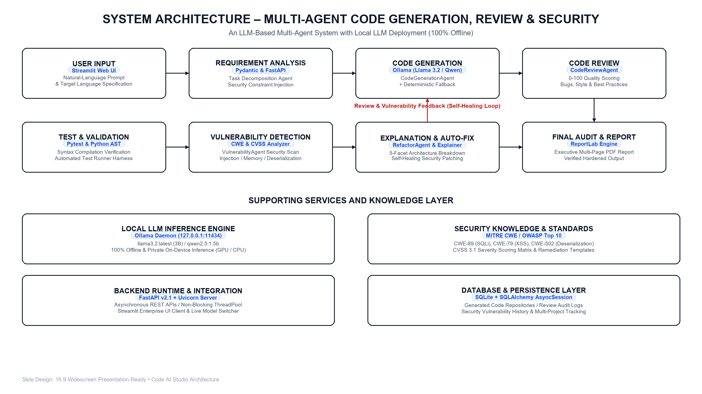

Slide 3
Multi-Agent Pipeline Workflow (Step-by-Step)
Stage 1 & 2: Ingestion
Tool: Streamlit & Pydantic
• Natural language prompt ingestion
• Target language selection (9 languages)
• Prompt decomposition & boundary analysis
• Security constraint injection
Stage 3 & 4: Gen & Review
Tool: Ollama & ReviewAgent
• Zero-shot local inference (Llama 3.2)
• 100% offline code synthesis
• Multi-metric quality evaluation
• Automated 0-100 quality scoring
Stage 5 & 6: Validation
Tool: Pytest & CWE Scanner
• AST syntax compilation check
• Automated unit test execution
• CWE pattern detection (CWE-89, 79, 502)
• CVSS 3.1 severity rating calculation
Stage 7 & 8: Fix & Report
Tool: RefactorAgent & ReportLab
• 5-facet architecture explanation
• Self-healing security patch generation
• Review feedback loop to Code Gen
• Executive PDF security audit report

Slide 4
